Slide 1
Circuit Theory & Analysis
Three Phase Power Measurement

Slide 2
Three Phase Circuits
Three Phase Power Measurement
Circuit Theory & Analysis

Slide 3
Objectives
  Measure three phase power using wattmeters
  Derive the relationship for three phase power in terms of wattmeter readings for the two-wattmeter method.
Circuit Theory & Analysis
Notes:
Student should be able to:
Use wattmeter to measure power.
Describe the two-wattmeter method of measuring three phase power with the aid of circuit diagram and phasor diagram.

Slide 4
Wattmeter
+
Current Coil
Wattmeter
+
Load
⎮Ζ ⎮∠φ
Voltage coil
V
Wattmeter connection to measure the power consumption of a single phase load Z = ⎮Z⎮∠φ
Circuit Theory & Analysis

Slide 5
Wattmeter
+
I
Current Coil
Wattmeter
+
Load
⎮Ζ ⎮∠φ
Voltage coil
V
Current coil - a coil of a few turns of thick wire with low resistance. Connected in series with the load and carries the load current I.
Circuit Theory & Analysis

Slide 6
Wattmeter
+
Current Coil
Wattmeter
+
Load
⎮Ζ ⎮∠φ
Voltage coil
V
V
Voltage coil - a coil of many turns of thin wire with high resistance. Connected across the load to measure the load voltage V.
Circuit Theory & Analysis

Slide 7
Wattmeter
+
I
Current Coil
Wattmeter
+
Load
⎮Ζ ⎮∠φ
Voltage coil
V
V
Wattmeter reading = voltage V across voltage coil
x current I through current coil x cos (phase angle between V & I)
Circuit Theory & Analysis

Slide 8
Wattmeter
+
I
Current Coil
Wattmeter
+
Load
⎮Ζ ⎮∠φ
Voltage coil
V
V
e.g. I = 4∠20° Α and V = 200 ∠−15° V,
wattmeter reading = 200 x 4 x cos (20°+15°) W
Circuit Theory & Analysis

Slide 9
One wattmeter method for measuring power of a 3-φ balanced star load
A
+
C.C
I_{A}
+
V.C
Z
Wattmeter
N
Z
I_{C}
C
Z
I_{B}
B
For a balanced star load, the power consumption of each phase is the same, therefore the total 3-phase power = 3 x wattmeter reading
Circuit Theory & Analysis

Slide 10
One wattmeter method for measuring power of 3-φ balanced delta load
A
I_{A}
3-phase power
= 3 x wattmeter reading
Z
Z
I_{B}
B
Z
+
C.C
V.C
+
I_{C}
Wattmeter
C
Circuit Theory & Analysis

Slide 11
Two wattmeter method for measuring 3-phase power
Most widely used method
Same connection apply to 3 wire both star and
delta loads
Shows the total power for both 3 wire balanced
and unbalanced loads
When the load is balanced, the power factor of
the load can be determined from the two
wattmeter readings
Circuit Theory & Analysis

Slide 12
Two wattmeter method for measuring power of a 3-φ star load
A
+
I_{A}
Z
V_{AC}
+
Z
N
W₁
I_{C}
Z
C
+
W₂
I_{B}
B
+
For W₁, V_{AC} should be used, NOT V_{CA}
Reading of W₁ = ⎟ V_{AC} ⎟ x⎟ I_{A} ⎟ x cos (V_{AC} ^ I_{A} )
Circuit Theory & Analysis
Notes:
Wattmeters connected to R and Y lines.

Slide 13
Two wattmeter method for measuring power of a 3-φ star load
A
+
I_{A}
I_{A} = 12 ∠−75° A
Z
V_{AC}
+
V_{AC} = 400∠−50° V
Z
N
W₁
I_{C}
Z
C
+
W₂
I_{B}
B
+
Reading of W₁ =⎟ V_{AC} ⎟ x ⎟ I_{A}⎟ x cos (V_{AC} ^ I_{A} )
= 400 x 12 x cos (75 ° - 50° ) W
Circuit Theory & Analysis

Slide 14
Two wattmeter method for measuring power of a 3-φ star load
A
+
I_{A}
Z
+
Z
N
W₁
I_{C}
Z
C
V_{BC}
+
W₂
I_{B}
B
+
For W₂, V_{BC} should be used, NOT V_{CB}
Reading of W₂ = ⎟ V_{BC} ⎟ x | I_{B} | x cos (V_{BC} ^ I_{B})
Circuit Theory & Analysis

Slide 15
Two wattmeter method for measuring power of a 3-φ star load
A
+
I_{A}
Z
+
Z
N
W₁
I_{C}
Z
C
+
W₂
I_{B}
B
+
Reading of W₁ = ⎟ V_{AC} ⎟ x ⎟ I_{A} ⎟ x cos (V_{AC} ^ I_{A} )
Reading of W₂ = ⎟ V_{BC} ⎟ x ⎟ I_{B} ⎟ x cos (V_{BC} ^ I_{B})
Circuit Theory & Analysis

Slide 16
Phasor diagram of a balanced inductive star load with impedance angle φ
V_{CN}
I_{C}
V_{CA}
V_{AB}
θ
30°
ω
V_{AN}
I_{B}
θ
θ
30°
V_{BN}
I_{A}
V_{AC}
V_{AC} is on the
opposite side of V_{CA}
V_{BC}
Circuit Theory & Analysis

Slide 17
Phasor diagram of a balanced inductive star load with impedance angle φ
V_{CN}
I_{C}
V_{CA}
V_{AB}
θ
30°
ω
V_{AN}
I_{B}
θ
θ
30°
V_{BN}
I_{A}
V_{AC}
V_{BC} ^ I_{B} =
θ +30°
V_{B}
V_{AC} ^ I_{A} =
θ - 30°
V_{BC}
Circuit Theory & Analysis

Slide 18
Two wattmeter method for measuring power of a 3-φ star load
Reading of W₁ = ⎟ V_{AC} ⎟ x ⎟ I_{A} ⎟ x cos (V_{AC} ^ I_{A} )
Reading of W₂ = ⎟ V_{BC} ⎟ x ⎟ I_{B} ⎟ x cos (V_{BC} ^ I_{B})
Referring to the phasor diagram, then
W₁ = ⎟ V_{AC} ⎟ x ⎟ I_{A} ⎟ x cos (θ - 30°)
W₂ = ⎟ V_{BC} ⎟ x ⎟ I_{B} ⎟ x cos( θ + 30°)
such that W₁ = V_{L} I_{L} cos (θ - 30°)
W₂ = V_{L} I_{L} cos (θ +30°)
W₁ + W₂ = √3 x V_{L} x I_{L} x cos θ
= total 3-phase power of balanced load
Circuit Theory & Analysis

Slide 19
Two wattmeter method for measuring power of a 3-φ star load
W₁ = V_{L} I_{L} cos (θ - 30°)
W₂ = V_{L} I_{L} cos (θ + 30°)
When the impedance angle or the power factor angle θ is small than 60°, both readings for W₁ and W₂ are positive.
When θ = 60°, then W₁ is +ve and W₂ is zero.
When θ > 60°, then W₁ is +ve and W₂ is -ve.
Circuit Theory & Analysis
Notes:
0⁰ Resistive load W₁ = W₂ = +Ve
30⁰ Net inductive load W₁ > W₂ = +Ve W₂ < W₁ = +Ve
60⁰ Net inductive load W₁ = +Ve W₂ = 0
>60⁰<90⁰ Net inductive load W₁ = +Ve W₂ = −ϖε

Slide 20
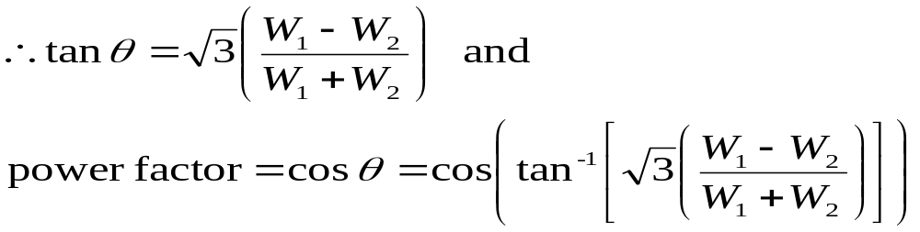
Two wattmeter method for measuring power of a 3-φ star load
W₁ = V_{L} I_{L} cos (θ - 30°)
W₂ = V_{L} I_{L} cos (θ + 30°)
W₁ + W₂ = √3 x V_{L} x I_{L} x cos θ
W₁ - W₂ = V_{L} x I_{L} x sin θ
Circuit Theory & Analysis

Slide 21
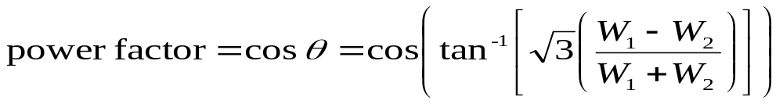
Summary of equations for finding wattmeter readings for balanced load
W₁ or W₂ = V_{L} I_{L} cos (θ − 30°)
W₁ or W₂ = V_{L} I_{L} cos (θ + 30°)
Substitute positive impedance angle, θ
Circuit Theory & Analysis
Notes:
First two formula are for wattmeters connected to R and Y lines and specific readings of wattmeters.
Formula requires a very good understanding of three phase theory.
Last formula - Easy to use. Indicate W₁ or W₂ =

Slide 22
Two wattmeter method for measuring power of a 3-φ delta load
The analysis for star load is equally applicable
to delta load, i.e. for the case of delta load,
balanced or unbalanced,
W₁ + W₂ = total delta load power consumption
Circuit Theory & Analysis

Slide 23
Two wattmeter method for measuring power of a 3-φ delta load
A
+
I_{A}
+
Z
Z
W₁
I_{B}
B
Z
+
W₂
I_{C}
C
+
Reading of W₁ = ⎟ V_{AB} ⎟ x ⎟ I_{A} ⎟ x cos (V_{AB} ^ I_{A} )
Reading of W₂ = ⎟ V_{CB} ⎟ x ⎟ I_{C} ⎟ x cos (V_{CB} ^ I_{C})
Circuit Theory & Analysis

Slide 24
Example 2.9
A 3-phase star connected load takes 86.5 kW at 440 V, 50 Hz and a power factor of 0.87 lagging.
Determine the line current and the readings on each of the two wattmeters connected between A & C and B & C lines respectively to measure the input power.
Circuit Theory & Analysis

Slide 25
Example 2.9
P = √3 V_{L} I_{L} cos θ
86.5 x 10³ = √3 x 440 x I_{L} x 0.87
I_{L} = 130.46 A
p.f. = cos θ = 0.87
θ = cos⁻¹ 0.87 = 29.54°
W₁ or W₂ = V_{L} I_{L} cos (θ - 30°)
= 440 x130.46 x cos (29.54° - 30°) = 57.4 kW
W₁ or W₂ = V_{L} I_{L} cos (θ + 30°)
= 440 x130.46 x cos (29.54° + 30°) = 29.1 kW
Circuit Theory & Analysis
Notes:
Use the easiest formula.

Slide 26
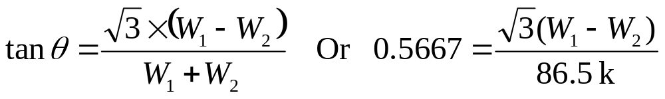
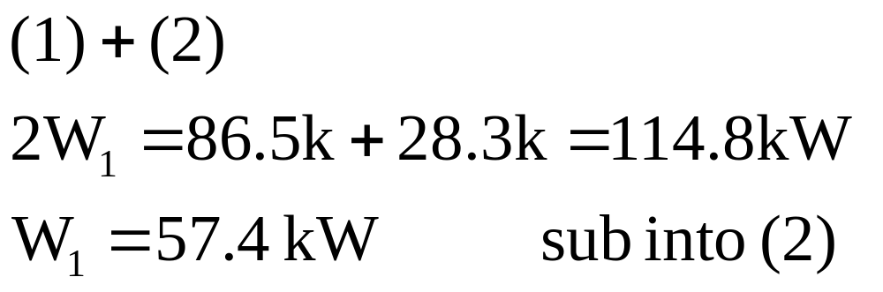
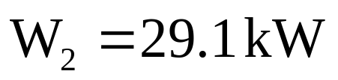
Example 2.9
Circuit Theory & Analysis

Slide 27
The End
Lee M L
Office: T12A522
School of EEE
Tel: 6879-0657

